Slide 1

Trip Type Prediction
@
Team8
Harshal Bagul
Aditi R Datta
Sukirti Gur
Ashwath Ramachandran
Yuwei Zhu

Slide 2
PROBLEM STATEMENT BACKGROUND
Walmart’s Woes:
Overall Shopping Experience Satisfaction: 75% (vs) Target at 80%
Customer Service Satisfaction: 60% (Both being the best in 2 years)
Objective:
Strategy:
Market Basket Analysis
Create the best shopping experience for every customer
Segment store visits into Trip Types
Customize shopping experience for each type

Slide 3
BRIEF PROJECT OVERVIEW
Source:
Kaggle - Walmart’s Website
Nature of Data Set:
Transactional Data
Training Set (with class variable) & Test Set ~ 0.65 Million Rows
To build a model to accurately predict Trip Type given values of the other variables
Project Objective:

Slide 4
OUR APPROACH
Preprocessing of Data
Model
Building
Validation &
Refinement
Prediction & Results

Slide 5
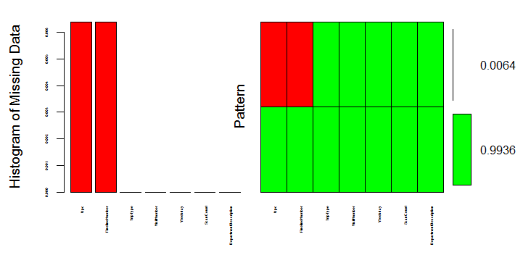
PRE PROCESSING OF DATA
The Training & Test Set Data were pre-processed with the below mentioned methods:
Factorizing Variables:
Numerical Fields → Categorical Fields
Missing Value Treatment:
Missing Values were less than 1%
Approaches:
Deleting Rows with Missing Values
Imputing with Columnar Mode
Missing Data – Feature wise View
*Mode Imputation was marginally better than Deletion

Slide 6
…..PRE PROCESSING OF DATA
Data Size Reduction:
R – Memory Errors handling ~ 0.65 Million Rows
Random Sampling – Size: 60,000 Rows*
Cross Validation Split:
Training Data split as 70 -30 for cross validation
Feature Engineering:
Levels for DepartmentDescription were converted to dummy variables*
* Applicable only to the R Model

Slide 7
MODEL BUILDING
Approach 1:
Evaluating the best choice of algorithm for the model using the entire dataset in Azure ML
Approach 2:
Model Building with the best algorithm using the sampled dataset in R
Algorithms Employed:
Multi Class Decision Forest
Multi Class Decision Jungle
Multi Class Logistic Regression
Multi Class Neural Network
Naïve Bayes Classification
Random Forest

Slide 8
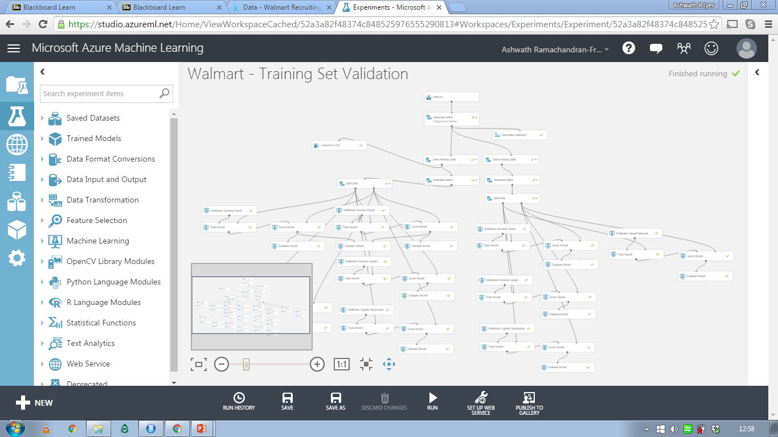
….MODEL BUILDING

Slide 9
VALIDATION & REFINEMENT
Algorithm Performance Comparison
Under fit:
Multi Class Decision Forest
Multi Class Decision Jungle
Naïve Bayes Classification
Random Forest
Over fit:
Multi Class Neural Network
Best fit:
Multi Class Logistic Regression
Algorithm | Overall Accuracy
Multi Class Decision Forest (n.Trees: 100, max.Depth: 4) | 0.267
Multi Class Decision Forest (n.Trees: 8, max.Depth: 128) | 0.279
Multi Class Decision Jungle | 0.267
Multi Class Logistic Regression | 0.824
Multi Class Neural Network | 0.969
Naïve Bayes Classification | 0.412
Random Forest | 0.361
Notes:
-> As complexity of the NN classification increases, the probability of overfitting increases substantially

Slide 10
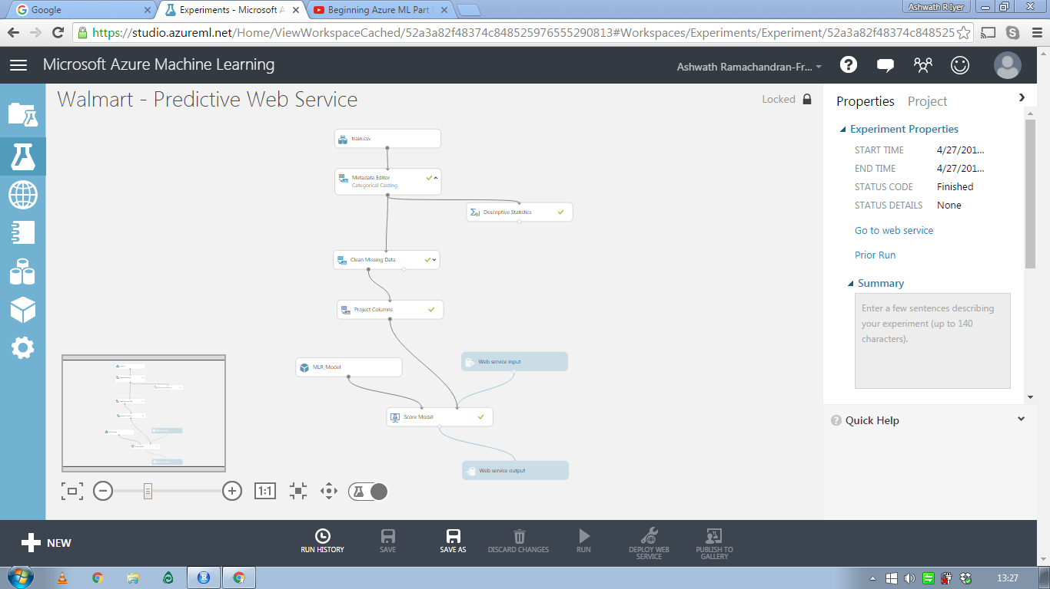
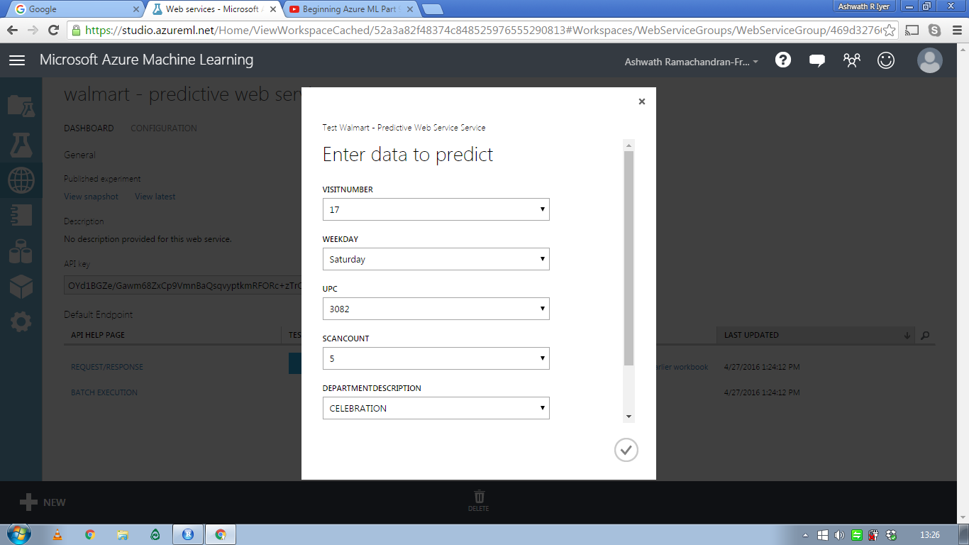
PREDICTION & RESULTS
Multi Class Logistic Linear Regression – R & Azure Implementation
R -- Package Implemented through H2O
Azure -- Predictive Model through API

Slide 11
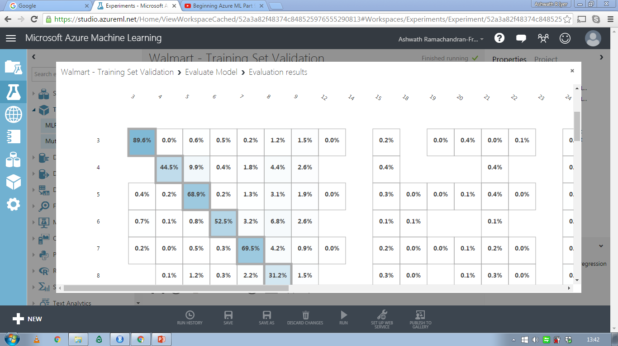
… PREDICTION & RESULTS
Confusion Matrix:
Overall Accuracy: 0.824
Micro Averaged Precision: 0.772
Micro Averaged Recall: 0.638

Slide 12
INTERPRETATION OF RESULTS
Multi-class Logistic Regression Model
Classification method that generalizes logistic regression to multiclass problems
Outcome of the model: Predict the probabilities of the different possible outcomes of a categorically distributed dependent variable
Prediction score:
Dot product of regression coefficients with explanatory variables
This score is the predicted probability that item ‘i’ belongs to type ‘k’
The prediction score across 38 classes decide the segmentation of items into respective type numbers
Precision: Positive prediction for a type that is averaged across 38 class types = 0.772
TP/TP+FP
Recall: Sensitivity of the type prediction that is averaged across all class types = 0.638
TP/TP+FN
Notes:
High Collinearity between explanatory variables makes it difficult to segment the items to different classes

Slide 13
WHAT DID NOT WORK?
Dataset of size ~0.65 Million wasn’t handled by R with all the Features included
Random Forest did not handle more than 53 levels in a variable
H2O Package – Handled Data with only 3 features at max

Slide 14
MANAGERIAL IMPLICATIONS
Better understanding and serving customers. Classifying trip types enables Walmart to create best shopping experience for every customer.
Segmentation of customer trip types will also help Walmart managers in product promotion and store layout.
Predictions of product demand provide general estimation for suppliers and reduce the inventory cost.

Slide 15
THANK YOU!

